Slide 1
Lecture 3: The Controller
PID Control and Speed Profile

Slide 2
Objective (to be completed over the next 2-3 weeks)
Create a system that allows you to easily control the angular and translational velocity of your mouse
Utilize feedback from multiple sensors (IR sensors, encoders, gyro)
Mouse should accelerate and decelerate at a constant rate, for both angular and translational movement
Mouse should not collide with walls
Control your mouse using practical measurement units, like millimeters

Slide 3
Overview
Most of the code will be in the systick handler
This will make sure that your mouse is always maintaining the correct velocity
Also makes sure we can obtain accurate velocities, since we know the time between systick calls (1 ms).
From outside your controller, you will be able to set the mouse’s two velocities (angular and translational). The controller will automatically accelerate or decelerate to that velocity, then maintain it.

Slide 4
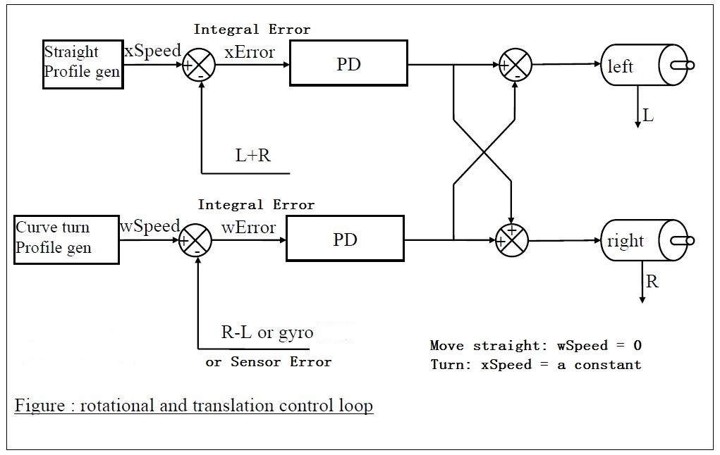

Slide 5
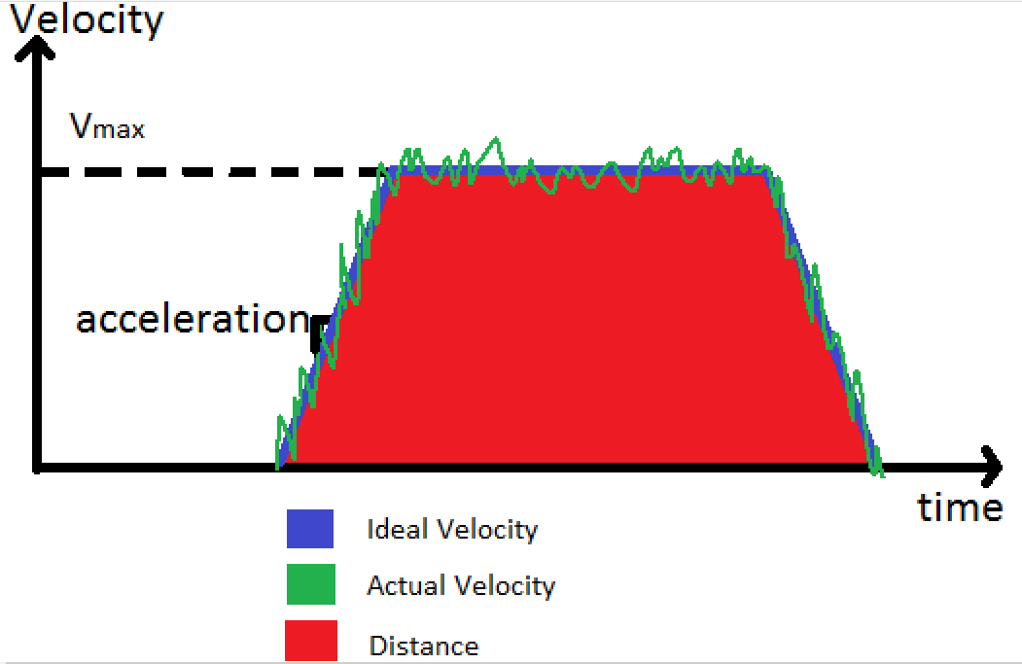
Speed Profile

Slide 6
The Steps
Within 1ms we need to finish all things as follow in sequence
Collect data from all Sensors(IR, gyro, encoders)
Decide the ideal velocities you want
Find the actual velocities from sensors as feedback(encoder value for translational velocity and gyro for rotational velocity)
Find difference between ideal velocity and feedback as Error
Input errors to PD controller in a clever way
Set the PWM of the motors based on the output from PD controller

Slide 7
Find the actual velocities
Take the derivative of the encoder counts
Gyro also gives you the angular velocity

Slide 8
Find the ideal velocities
If you are accelerating or decelerating, then add or subtract (respectively) your acceleration rate from the previous ideal velocity to get the current ideal velocity
If you are not accelerating or decelerating, then your current ideal velocity is unchanged
This creates the ideal trapezoidal shape for your speed profile

Slide 9
Get the PID input
For translational:
We really only have encoders for feedback, since the gyro doesn’t tell us translational movement and the front sensors don’t have a wall close enough most of the time
Therefore we can use the ideal velocity minus the actual velocity for our PID input
For angular:
Same as the translational, but we can add sensor error and gyro error.
You will need to scale the gyro output so that has roughly the same value as the encoder error
Note that the sensor error is a positional error, while the encoder and gyro errors are velocities

Slide 10
Apply PID to errors
The velocity error is already your D (remember we took the derivative of the encoder count at the beginning)
Integrate the velocity error to obtain P.
Essentially what we want is a “Positional PD Controller”.
However, we also want to use PI for our sensor error.
Integrating the sensor error allows us to permanently correct our angle if the angle of our mouse is off.
Using a PI controller for our encoder velocity error, gyro error, and (positional) sensor error will give us everything we want.

Slide 11
Set the PWM of the motors
Something like this should be at the end of your systick function:
setLeftPwm(errorX – errorW);
setRightPwm(errorX + errorW);
errorX is the translational error
errorW is the angular error
You can change the direction of errorW if you want, just switch the + and -

Slide 12
Get sensor error
if(DLSensor > DLMiddleValue && DRSensor < DRMiddleValue)
sensorError = DLMiddleValue - DLSensor;
else if(DRSensor > DRMiddleValue && DLSensor < DLMiddleValue)
sensorError = DRSensor - DRMiddleValue;
else
sensorError = 0;

